Slide 1


Slide 2

Group 1
04:00 - 09:00
14:00 - 17:00
Status: Off
2 hrs 25 mins
remaining

Slide 3
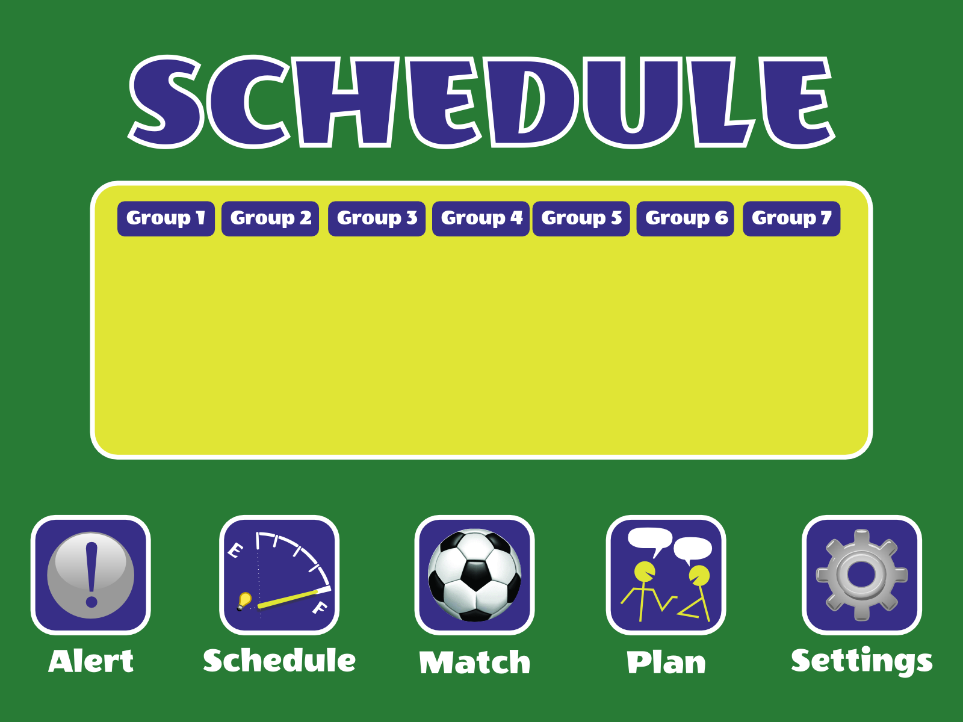
Sunday 03:00-09:00 13:00-18:00
Monday 10:00-17:00 19:00-24:00
Tuesday 09:00-15:00 18:00-23:00
Wednesday 08:00-14:00 18:00-12:00
Thursday 06:00-13:00 17:00-22:00
Friday 05:00-11:00 15:00-21:00
Saturday 04:00-10:00 14:00-19:00

Slide 4

Group 1
Group 2

Slide 5
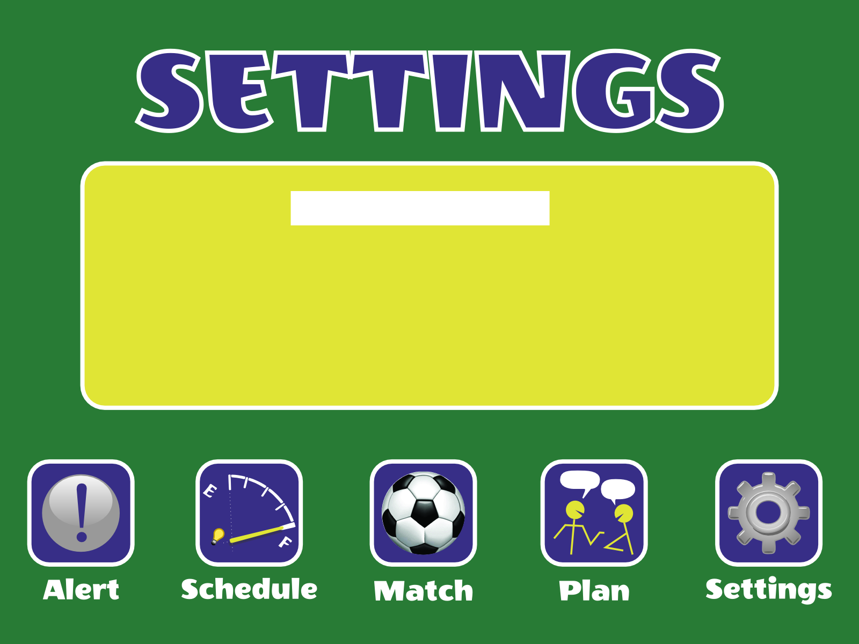
Group 1

